Slide 1

Support the Programs of
Crossroads of America Council through
Friends of Scouting
Presenter’s Name
Presenter’s Email
Presenter’s Phone Number

Slide 2

What is Friends of Scouting?

Slide 3

Crossroads of America has continued to support
Scouting throughout central Indiana in 2020:

Slide 4

Our Youth Need Your Support
Consider Supporting
One Scout Through a Year of Program
Helps Cover the Cost of ALL the Great Things you just Saw in the Video
$225
ALL & ANY Gifts are GREATLY APPRECIATED!!!
Make a Pledge Today and Pay Before 12/31/2021
Pay as You Go!

Slide 5




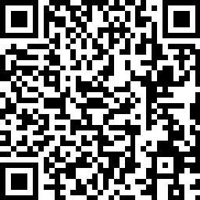
Three Easy Ways to Give
Text
“GIVE2CAC”
to 317-813-7125
Visit
give2cac.org
Email your Unit Coordinator
  - Give Now to make a pledge and
  Pay It Now
  - Give Monthly to set up a recurring
  payment on your credit card
  - Pledge your Support to make a pledge
  now
  - Name
  - Address
  - Phone Number
  - Email Address
  - $ Amount
  - How you’d like to give (Once, Twice, Monthly, etc)

Slide 6
THANK YOU for your Investment!
Text
“GIVE2CAC”
to 317-813-7125
Visit
give2cac.org
Email your Unit Coordinator

