Slide 1
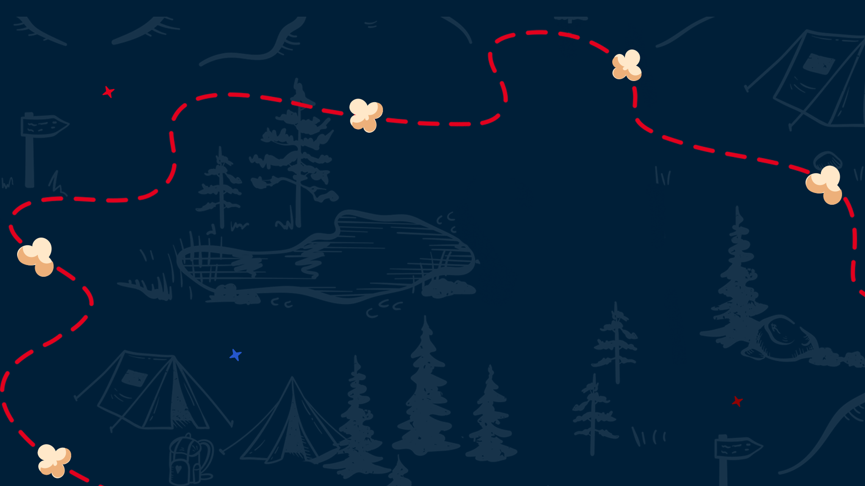

Crossroads of America Council
Unit Leader Training

Slide 2


Powered by Popcorn
Scout Fundraising
Benefits for Scouts
Personal growth program that can be applied to advancement opportunities and service projects.
Earn Amazon eGift Cards
  Millions of prize choices
  Scouts choose the prizes they want
Scouts Learn
How to help others around them
Public speaking & math skills
Salesmanship & perseverance
How to earn their own way
The value of hard work
How to handle rejection

Slide 3


prepare
pre·​pare
prepared; preparing
transitive verb
to make ready beforehand for some purpose, use, or activity

Slide 4

Ideal Year of Scouting
Scout Fundraising
Plan Program
List activities & adventures
Hold a brainstorming session with families
Add a new trip or campout for excitement.
Budget
Assign costs and expenses.
Add camp, registration fees, advancements & Unit dues.
Calendar
Provide a monthly calendar of activities so parents can add dates to their family calendars.
Set Goals
Total Program Costs ÷ Unit Commission = Unit Sales Goal.
Divide Unit goal by # of Scouts to get Scout goals.
Raise the Money
Commit to achieving the Unit’s goal with one fundraiser.
Less time fundraising = more time Scouting!
Enjoy the Year!
Notes:
Include family planner (from IYOS scope sheet)

Slide 5
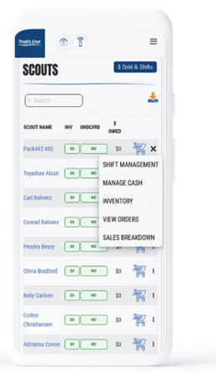
Leader Portal
Scout Fundraising
Your one-stop-shop for sale management!
Order Popcorn
Invite Scouts to register; manage Scout roster.
Easily set Unit and Scout goals.
View real time reporting of sales, inventory and cash management; all in one place.
Unit-to-Unit product transfers. No Council intervention needed.
Create, schedule, and manage storefront sites and shifts.

Slide 6
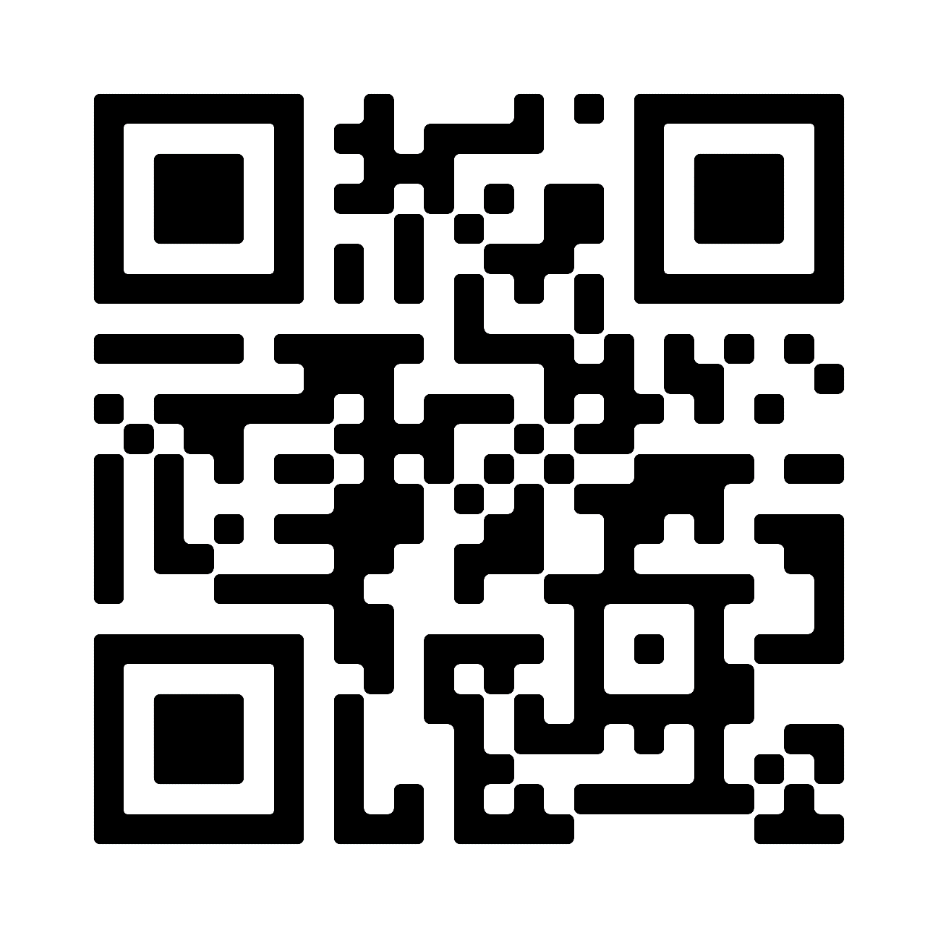


Header
Leader Training
Scout Fundraising
Videos
Leader Portal - Training page
Returning Leaders
What’s New?
New Leaders
Ideal Year of Scouting
Unit Kickoff & Parent Buy-In
Leader Portal training
Storefront Best Practices
Storefront Reservations & Management
Managing Inventory
Sale Resources
Leader Portal - Training page
Leader Guide
Unit Program Planner
Scout & Parent Guide
Banner
Table Payments Sign
Scout Pitch
Q&A Webinars
Please watch the training videos before
Trail’s End experts will stay on and answer every question!

Slide 7
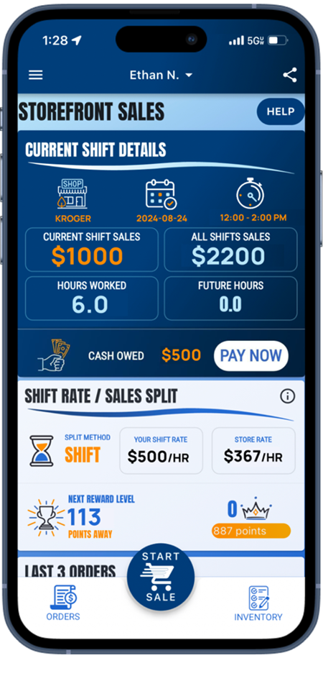
Header
Trail’s End App
Scout Fundraising
Save Time Managing Your Sale!
Scouts use the App to…
track and report real-time storefront, wagon and online sales
accept cash and credit cards
track inventory by Scout and storefront
schedule Scouts for storefronts
Free Credit Card Processing
Powered by Square | Paid by Trail’s End
Available in Apple and Google Play Stores
New Scouts
Use the Unit’s Trail’s End Code or their zip code to register.
Families can use one email for multiple accounts.
Returning Scouts
Sign in using 2023 username
Families: click name dropdown at top of screen to switch between accounts in the App

Slide 8

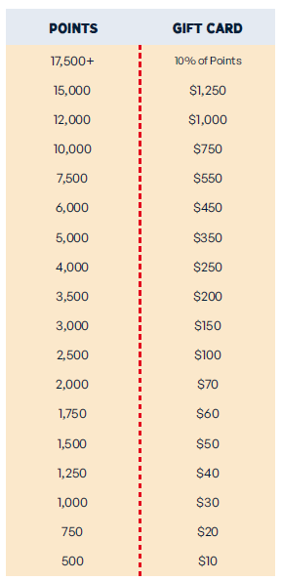
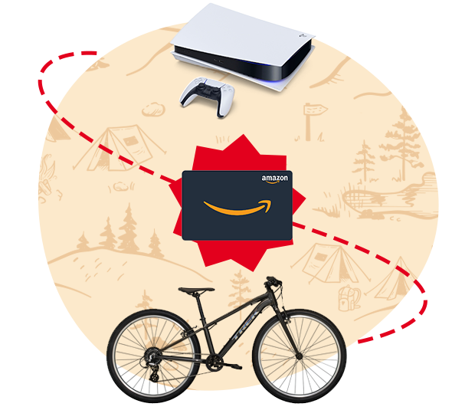
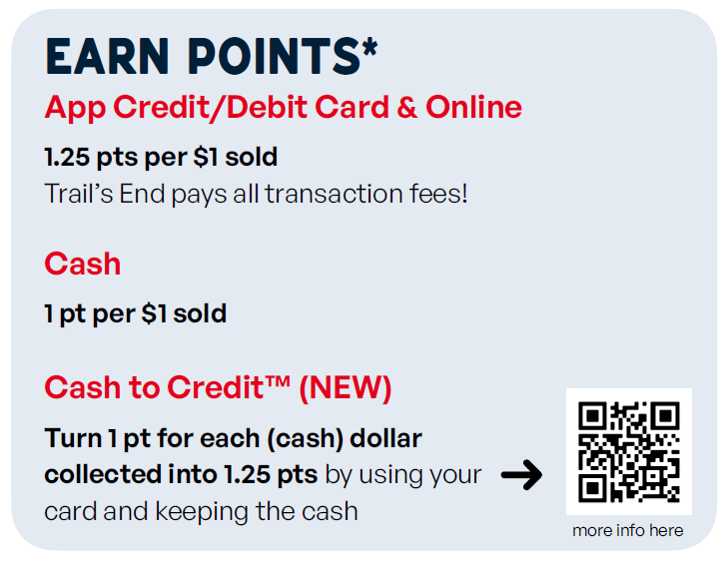

Scouts accumulate points towards Amazon eGift Cards when recording sales in the Trail’s End App.
Scout
Rewards
Bonuses
Sell $500/hour per Scout for any 2 hour storefront shift or longer (July 1 – Dec 15) and earn 0.5 bonus points per $1 sold. To qualify, Unit must select the “One Scout and their parent per shift” split method.
Sell $250+ online (July 1 – Aug 31) and earn 100 bonus points.
Scout Fundraising
Notes:
Make point values BIGGER; Parent Pay Now

Slide 9
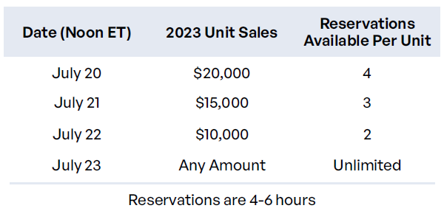
Header
Storefront Settings & Reservations
Scout Fundraising
The BEST, Most Fair & Highest Selling split is One Scout and their Parent
Default Settings
Before reserving, set your split method.
One Scout and their Parent is the BEST split!
    Scouts are credited for each sale they record.
    Safest and Scout sales won’t go down like other splits.
    Scouts sell $244 more than other splits.
    Units raise $50 more per hour per Scout.
Best practice: 2 hour shifts.
Reservations
Trail’s End is reserving the best selling times and storefronts for your Scout families!
Reserve on Storefront Reservations page
Best hours will be highlighted
Notes:
One Scout and their Parents

Slide 10

sell
sell
sold; selling
transitive verb
to give up (property) to another for something of value (such as money)

Slide 11

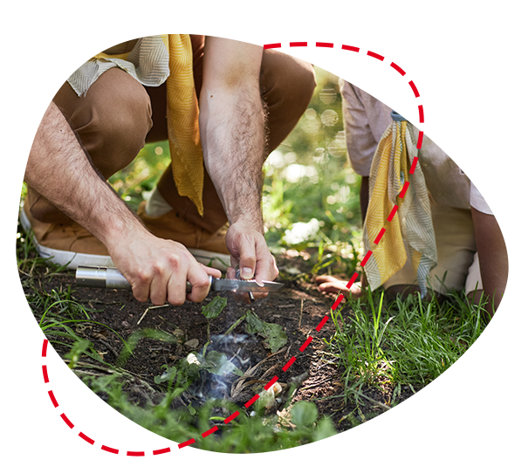

Ways to Sell
Scout Fundraising
Storefronts
Setup tables at high foot traffic locations.
Scouts sell to customers coming in and out of stores.
Best Practice: One Scout and their parent per shift.
Wagon
Sell door-to-door
Best Practice: Bring product with you to avoid second trip to deliver.
Scouts can record undelivered orders in App.
Online
Sell virtually to family and friends by sharing your online fundraising page via social, email & text.
Product ships to the customer.
Safest way to sell!

Slide 12
Header
Storefront Best Practices
Scout Fundraising
One Scout and their Parent - Making $500/hour a Reality!
Prep
Enough popcorn to sell $500 per hour.
A fully charged phone with the Trail’s End App.
Bluetooth Square reader
6-foot table & banner
Cash box with small bills.
Scout should use the restroom before shift.
Place products highest to lowest.
NEVER put prices on table.
Scout Role
Wear your uniform.
Stand in front of the table.
Smile & walk up to everyone.
Look the customer in the eye and give your pitch.
Guide them to the table to pick their products.
It helps to memorize the prices!
Let your parent handle the money so you can get more customers.
Parent Role
Encourage your Scout to keep asking. No’s happen, that’s okay!
Handle table and products setup.
Stand and thank everyone!
Share what your Scout will get with the consumers’ support.
Enter orders so your Scout can get more customers.
Submit all donations in App.
Notes:
Parent Pay Now & Heroes & Helpers

Slide 13
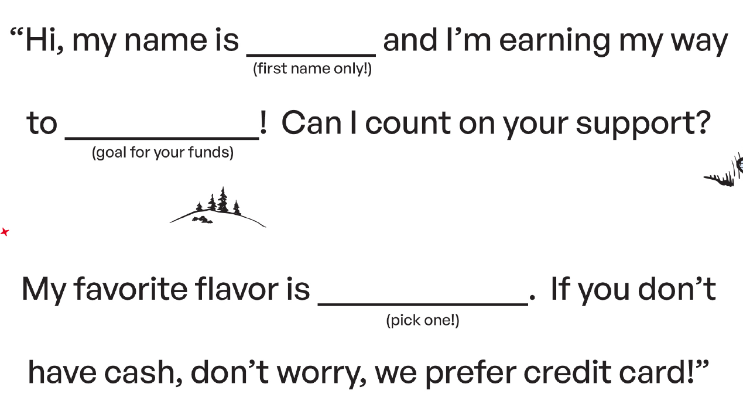
Header
Scout Pitch
Scout Fundraising
NEVER, NEVER, NEVER ask customers to buy popcorn. It’s to support You!
Even if the customer says no, always say, “Thank you” and “Have a good day.”
Notes:
Parent Pay Now & Heroes & Helpers

Slide 14






Header
Credit Card
Scout Fundraising
Cash to Credit
Convert cash recorded in App.
Rewards: Turn 1 pt for each (cash) dollar collected into 1.25 pts
Credit is Best for Scouts
Safer, easier & higher sales for Scouts!
Trail’s End pays all fees!
Ways to accept credit in App:
      Square Bluetooth - contactless cards, chip cards, Apple Pay & Google Pay
      Square Swipers: Lighting (Apple) & Headphone jack (Android)
      Manual Entry (no reader): type card
      Apple Pay, Google Pay & Cash App Pay: use share feature at checkout for customers to pay on their device!
^{NEW}
Parents
Use their card and keep the cash.
Available at end of shift (up to 30 minutes after).
Scouts on that shift earn more Rewards.
Leaders
Use their card and keep the cash.
Available after shift until 2:59 am ET.
Scouts on shifts that day earn more Rewards.

Slide 15







Products
Scout Fundraising
$25
$25
$25
$20
$17
$15
^{NEW PROCESS}
Heroes & Helpers Donations
Donations in App will be automatically processed nightly & reflected on Unit orders, eliminating manual ordering, and saving time!
Products and flavors consumers purchase every day.
Fewer products simplifies the sale for Councils, Units & Scouts.

Slide 16


Header
Online Best Practices
Scout Fundraising
Safe & Easy
Trail’s End ships the product directly to the customer.
No handling of products or cash for Scouts or Unit.
As many traditional products and prices as possible.
Additional products online.
Customize Page
Upload a profile picture.
Write a description - “Tell your customers why they should support Scout fundraising.”
Select your favorite product.
Share
Share your online fundraising page link with family and friends!
Use the App to post on social, send emails and texts & generate a QR code.
Follow-up with customers who have not bought.
Notes:
Parent Pay Now & Heroes & Helpers

Slide 17

wrap up
wrap·up
wrapped up; wrapping up; wraps up
transitive verb
to bring to a successful conclusion

Slide 18





Steps
Scout Fundraising
Place Final Order
Collect undelivered orders from Scouts.
Go to “Popcorn Orders” page in Leader Portal.
The system will highlight shortages using App sales and previous Unit orders.
Request Unit Payout
Go to Account Summary page in Leader Portal.
Ensure Unit Invoice is paid.
How to request payout:
Enter the Unit’s bank account on Unit Info page.
Click Request Payout.
Submit Rewards
Submit Unit’s Rewards order when ready.
Amazon eGift Cards will release 5 days later for Scouts to claim in App.
Submit again for Scouts that sell more and earn a bigger eGift Card.

Slide 19
Header
Council Sale Details
Scout Fundraising
Dates
7/20- Storefront Reservations
8/1- Initial Order Due
8/17- Sale Starts
8/25- 1st Replenishment Order
9/1- 2nd Replenishment Order
9/8- 3rd Replenishment Order
9/15- 4th Replenishment Order
9/22- 5th Replenishment Order
9/29- 6th Replenishment Order
10/27- Final Order Due
11/8- Final invoices to Units
11/14- Final invoice due
Commission
Base- 33%
Bonus-
  Register for sale by 5/15 +2%
  $25k-34k in sales +2% -OR-
  $35k-44k in sales +3% -OR-
  $45k + in sales +4%
Online- 35% for all sales
Pickup
Initial order pickup @ IDS
Replenishment & final orders pickup @ IDS or Belzer
8/15&16- Initial Order Pickup
8/29- 1st Replenishment Pickup
9/5- 2nd Replenishment Pickup
9/12- 3rd Replenishment Pickup
9/19- 4th Replenishment Pickup
9/26- 5th Replenishment Pickup
10/3- 6th Replenishment Pickup
11/14- Final Order Pickup

Slide 20
Header
Council Sale Details
Scout Fundraising
Scout Incentives
Sell $1000+ = Slushie cup and free slushies at summer camp in 2025
2 online sales of $60+ = 75 bonus Amazon Reward points
Top Seller Banners and Recognition at Summer Camp 2025
Top Seller Experiences at the Skip Lange Innovation Center
Unit Incentives
Increase sales over last year’s to earn Crossroads of America Council gift cards
$1k increase = $100 CAC gift card
$2.5k increase = $200 CAC gift card
$5k increase = $400 CAC gift card
$7.5k increase = $600 CAC gift card
$10k increase = $800 CAC gift card
New Unit Incentive
RISK free opportunity for any unit that did not sell in 2023!
Unit receives starter kit worth $570- product mix will be predetermined
Unit is not charged for product
Unit sells product and keeps commission
Council will take responsibility for redistributing any unsold product

Slide 21
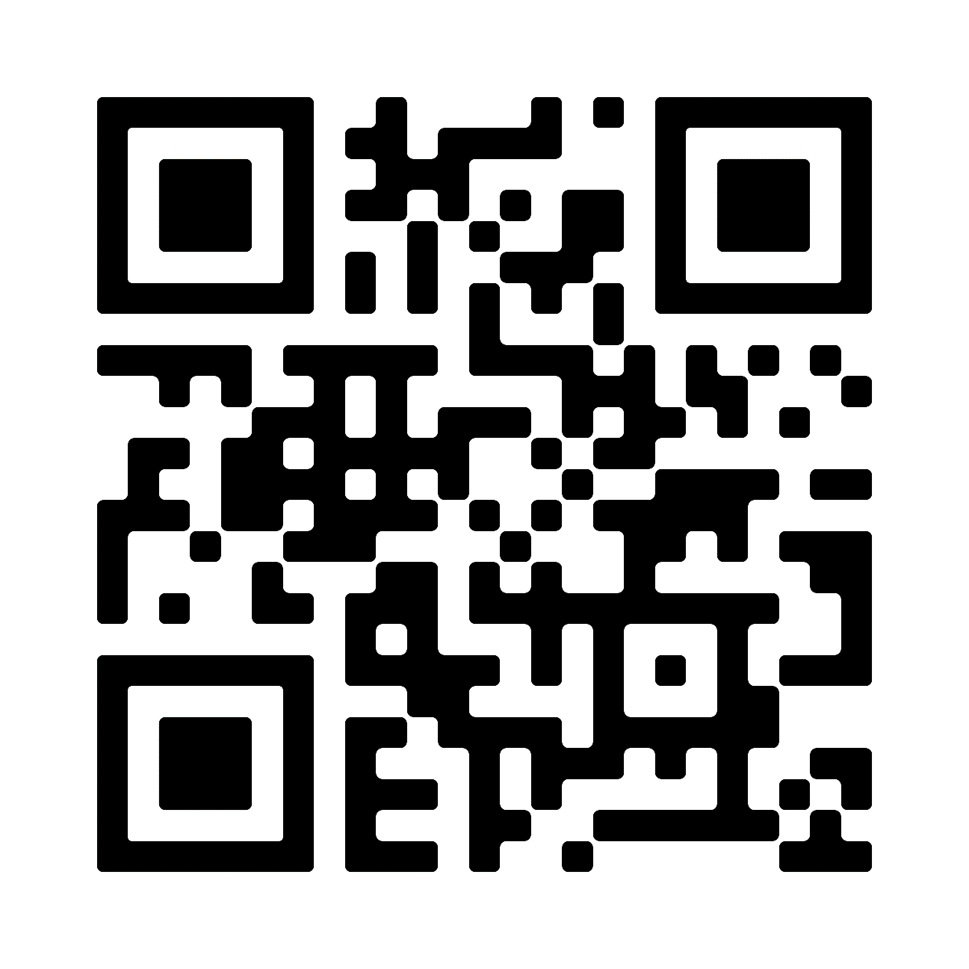
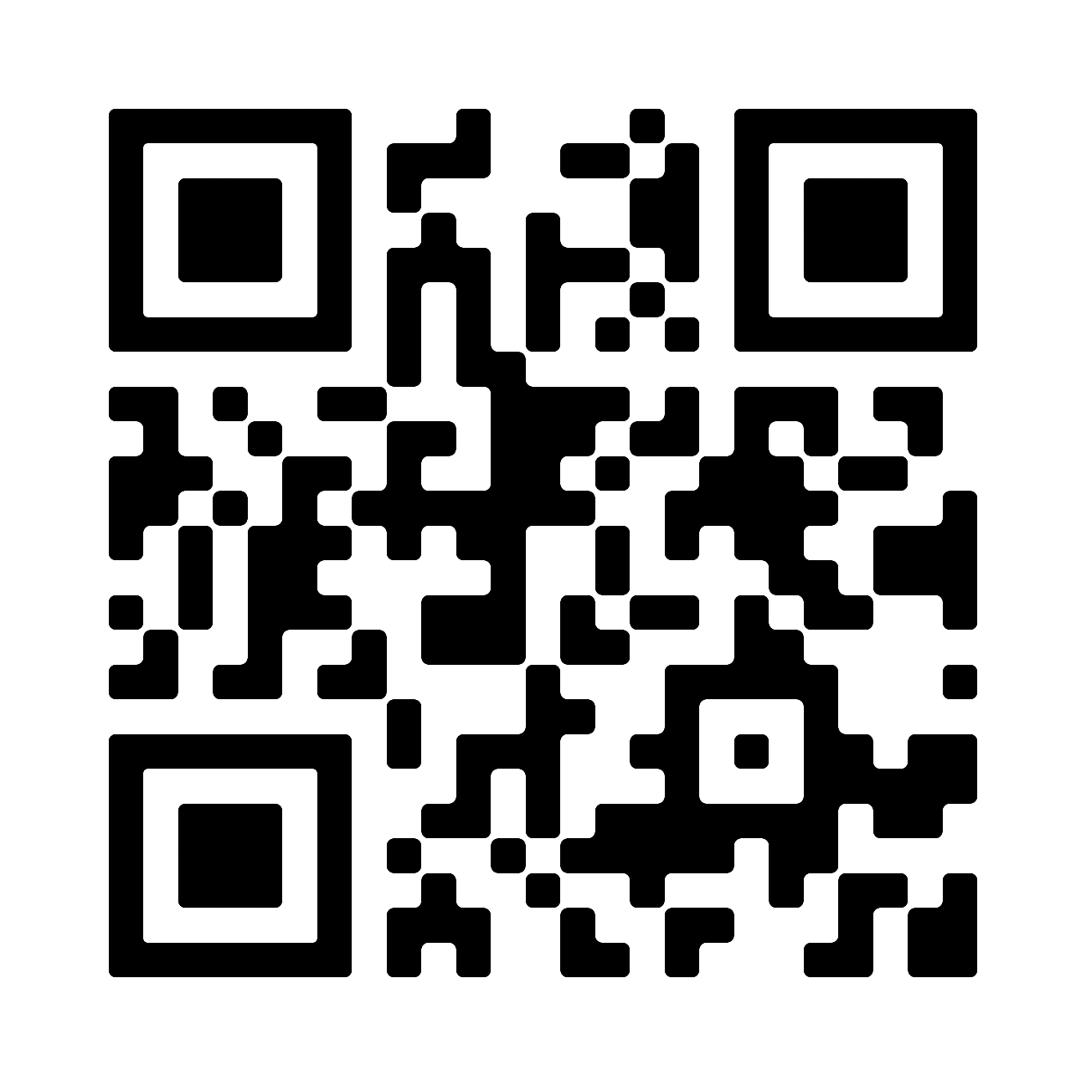
Support
Scout Fundraising
Trail’s End Support
Visit our FAQ page for answers to commonly asked questions & to open a ticket.
Council Support
Anne Herriage (Staff Advisor)
Anne.Herriage@crossroadsbsa.org
317-813-7058
Jordan Sandoe (Staff Advisor)
jorsand@crossroadsbsa.org
317-813-7121
Kim Julius (Council Kernel)
kimthebeliever1@gmail.com
Anna Beach (District Kernel)
aeheins@gmail.com
Popcorn Page:
crossroadsbsa.org/support/popcorn/
Facebook Group
Join Trail’s End Popcorn Community for best practices, support, news, and answers to questions.

Slide 22


Scout Fundraising
Thank You!
Blank Background

